Slide 1

Monument Health
Breastfeeding Friendly/Lactation Support

Slide 2
Breastfeeding Friendly
Why:
  Breastfeeding employees whose companies provide breastfeeding-friendly environments consistently report improved morale, better satisfaction with their job, and higher productivity.
  Caregiver Requests
  Monument Health Breastfeeding Friendly Designation February 2018
Initiation of Process
  Given by HR upon Leave of Absence request
  Manager access

Slide 3
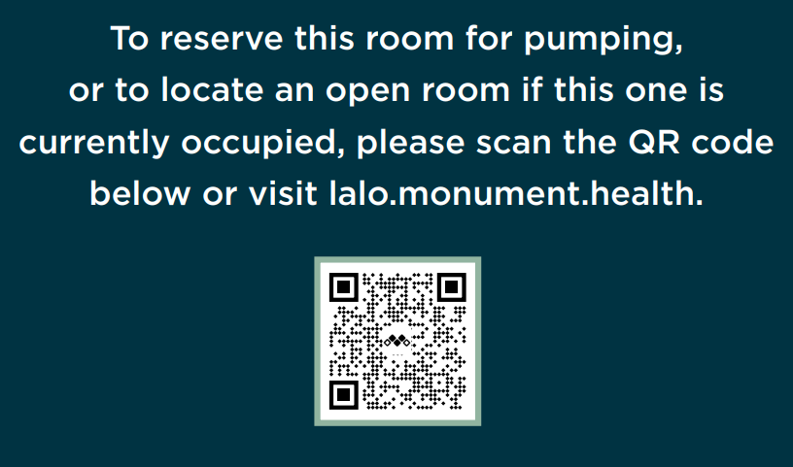
Room and locations
1st Floor (EAud) W1501
1st Floor (in Lactation) W1615
2nd Floor ED S2418
3rd Floor HVU S3173
4th Floor HVI S4355
7th Floor T7127
10th Floor T10127
MHOSH 2-2124
2nd Floor MH Rehab
2nd Floor Turbine 240
2nd Floor MHC 282

Slide 4
Breastfeeding Friendly
https://lalo.monument.health/ - phones or computers
For universal badge access contact livewell@monument.health or call 755-8040
Refrigeration is not standard in the lactation rooms
Hospital grade breast pumps are now standard items in lactation rooms
  Symphony Initiation Kits are required for use
    Available at Monument Health HME for approximately $25
    Item number 0110129 67350S

Slide 5
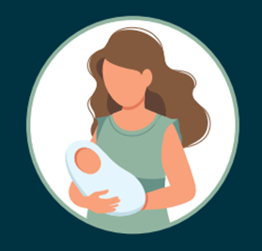
Lactation Rooms – September 21 Report Out
Unique Users: 14
Total Room Checkouts: 164
Data: August 2021 -September 15, 2021

Slide 6
Lactation Rooms – As of April 22
Total Unique Users: 53 (1 visitor)
Average Unique Users/Month: 14
Total Room Checkouts: 746
Average Checkouts/Month: 153
Data: August 2021 –April 22, 2022

Slide 7
Room Checkouts
Data: August 2021 – April 22, 2022

Slide 8
Room Checkouts
Data: August 2021 – April 22, 2022

Slide 9
Room Checkouts
Data: August 2021 – April 22, 2022

Slide 10
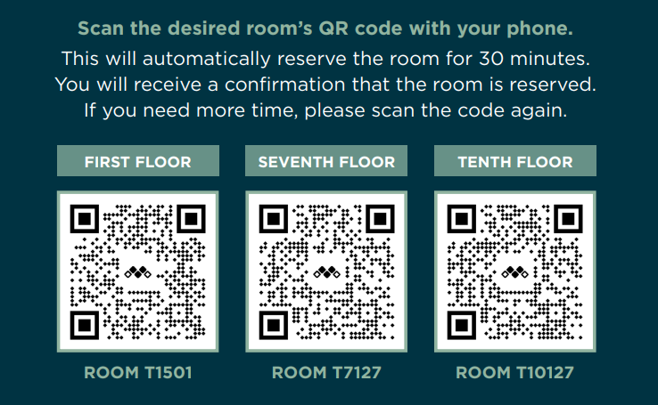
Breastfeeding Friendly for Visitors/Vendors

Slide 11
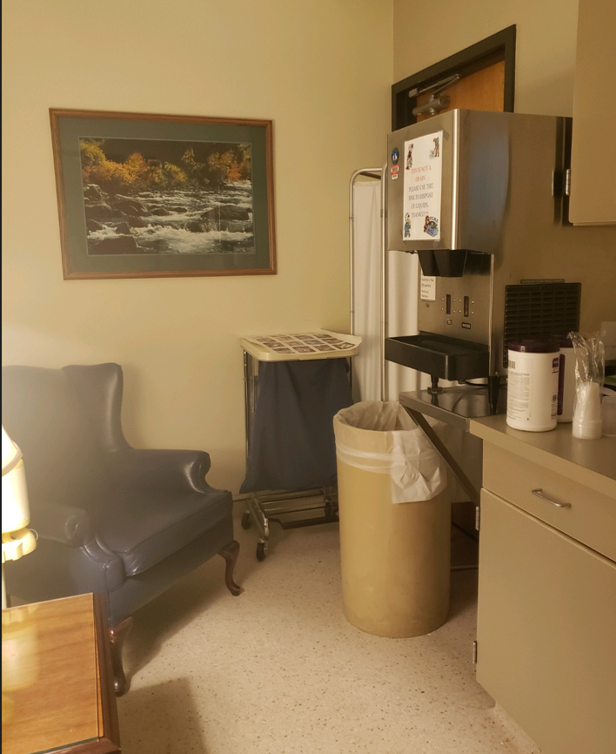
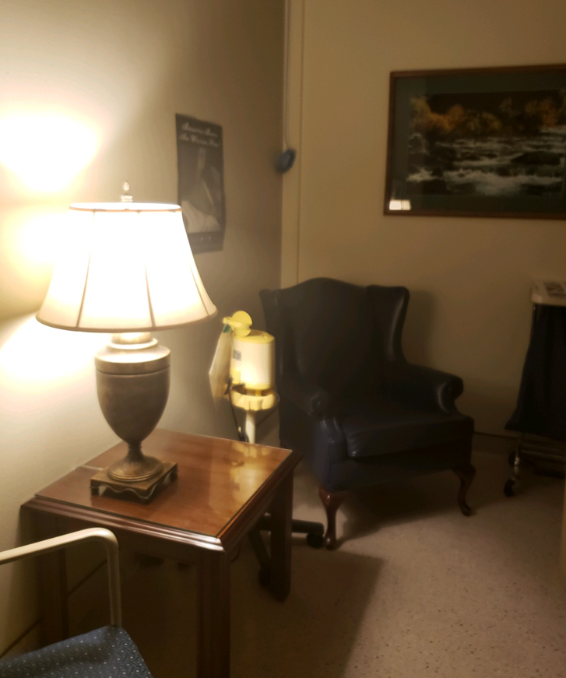
Breastfeeding Friendly

Slide 12
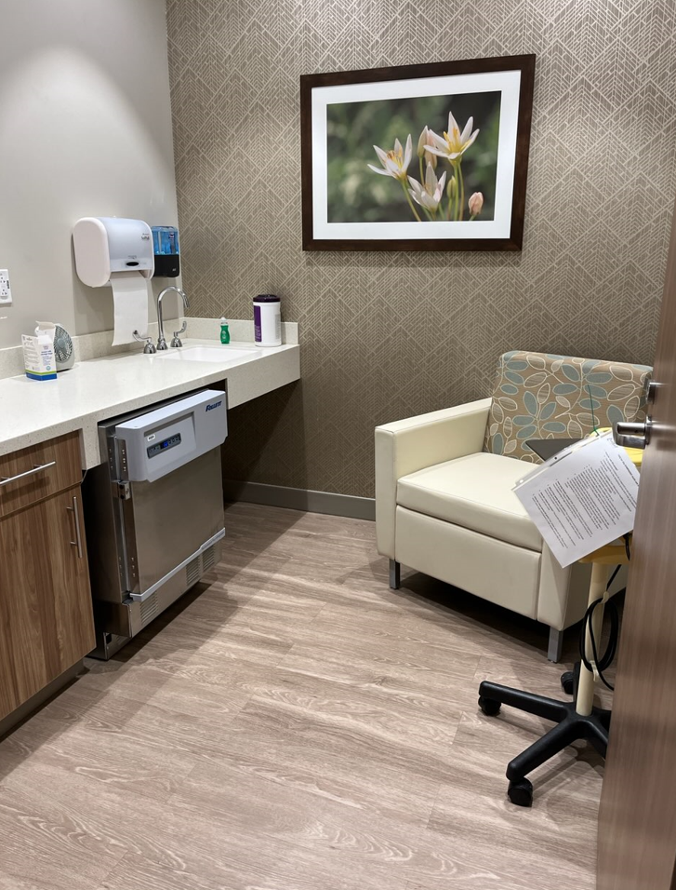
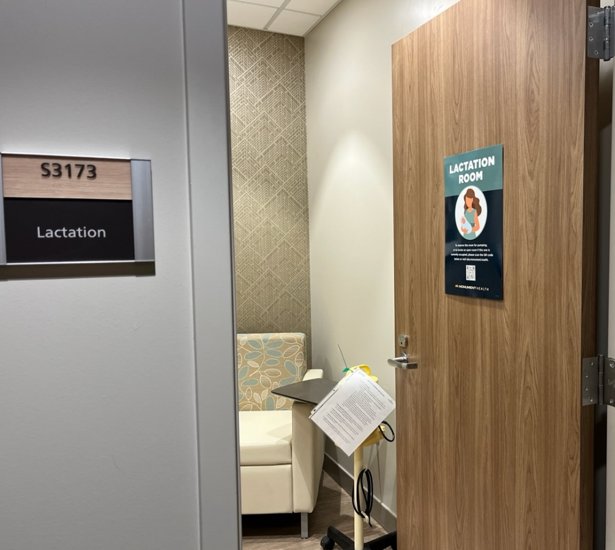
Breastfeeding Friendly

